Slide 1

Presentation on House: Price Prediction
PRESENTED BY: ARPAN PATTANAYAK

Slide 2
Index
Introduction
Problem Statement.
Problem Understanding.
What is Housing Price Prediction?
Importance of housing price prediction.
Exploratory data analysis.
Visualizations.
Analysis.
Model Building.
Hyper Parameter Tunning.
Saving the model and predictions from saved best model.
Conclusion.

Slide 3
Introduction
Houses are one of the necessary need of each and every person around the globe and therefore housing and real estate market is one of the markets which is one of the major contributors in the world’s economy. It is a very large market and there are various companies working in the domain
In this study, a machine learning model is proposed to predict a house price based on data related to the house (its size, the year it was built in, etc.). During the development and evaluation of our model, we will show the code used for each step followed by its output. This will facilitate the reproducibility of our work.

Slide 4
Problem Statement:
A US-based housing company named Surprise Housing has decided to enter the Australian market. The company uses data analytics to purchase houses at a price below their actual values and flip them at a higher price. For the same purpose, the company has collected a data set from the sale of houses in Australia. The data is provided in the CSV file below.
The company is looking at prospective properties to buy houses to enter the market. You are required to build a model using Machine Learning in order to predict the actual value of the prospective properties and decide whether to invest in them or not. For this company wants to know:
• Which variables are important to predict the price of variable?
• How do these variables describe the price of the house?

Slide 5
Problem Understanding
House price prediction can help the developer determine the selling price of a house and can help the customer to arrange the right time to purchase a house. House Price prediction, is important to drive Real Estate efficiency. As earlier, House prices were determined by calculating the acquiring and selling price in a locality. Therefore, the House Price prediction model is very essential in filling the information gap and improve Real Estate efficiency. The aim is to predict the efficient house pricing for real estate customers with respect to their budgets and priorities. By analysing previous market trends and price ranges, and also upcoming developments future prices will be predicted. ... cost of property depending on number of attributes considered. Now as a data scientist our work is to analyse the dataset and apply our skills towards predicting house price.

Slide 6

What Is Housing Price Prediction ?
Prediction house prices are expected to help people who plan to buy a house so they can know the price range in the future, then they can plan their finance well. In addition, house price predictions are also beneficial for property investors to know the trend of housing prices in a certain location.

Slide 7

Importance of House Price Prediction
House Price prediction, is important to drive Real Estate efficiency. As earlier, House prices were determined by calculating the acquiring and selling price in a locality. Therefore, the House Price prediction model is very essential in filling the information gap and improve Real Estate efficiency

Slide 8
Data Analysis and Model Building Flowchart
Import Libraries
Import Datasets
Data Preprocessing
Identifying Outliers and Skewness
EDA & Visualizations
Finding and Treating Null Values
Ordinal Encoding
Checking Correlation & VIF
Model Building
Saving the Model & Prediction
Hyper Parameter Tuning
R2 score, CV & evaluation metrics

Slide 9
Exploratory Data Analysis
As a first step I have imported required libraries and I have imported the datasets which were in csv format.
Then I did all the statistical analysis like checking shape, nunique(unique value each column contains), value counts, info etc…..
While checking the info of the datasets I found some columns with more than 80% null values, so these columns will create skewness in datasets so I decided to drop those columns, since it seem to me as unnecessary.
Then while looking into the value counts I found some columns with more than 85% zero values this also creates skewness in the model and there are chances of getting model bias so I have dropped those columns with more than 85% zero values.

Slide 10
Exploratory Data Analysis
While checking for null values I found null values in most of the columns and I have used imputation method to replace those null values (mode for categorical column and mean for numerical columns).
In Id and Utilities column the unique counts were 1168 and 1 respectively, which means all the entries in Id column are unique and ID is the identity number given for particular asset and all the entries in Utilities column were same so these two column will not help us in model building. So I decided to drop those columns.
To visualize the data, I have separated categorical and numerical variables based on their types. That is categorical types as Nominal and Ordinal, numerical types as Continuous and Discrete.

Slide 11
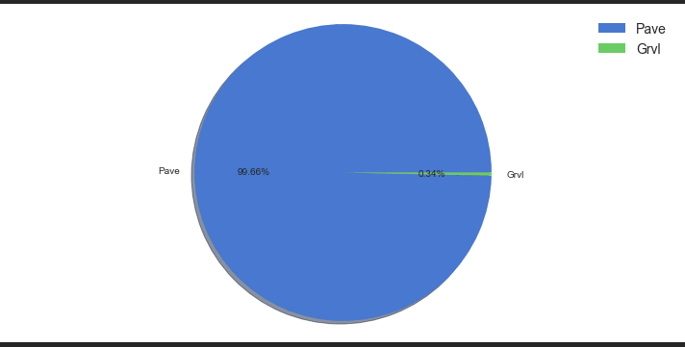
Visualization of categorical columns through Pie-Plot

Slide 12
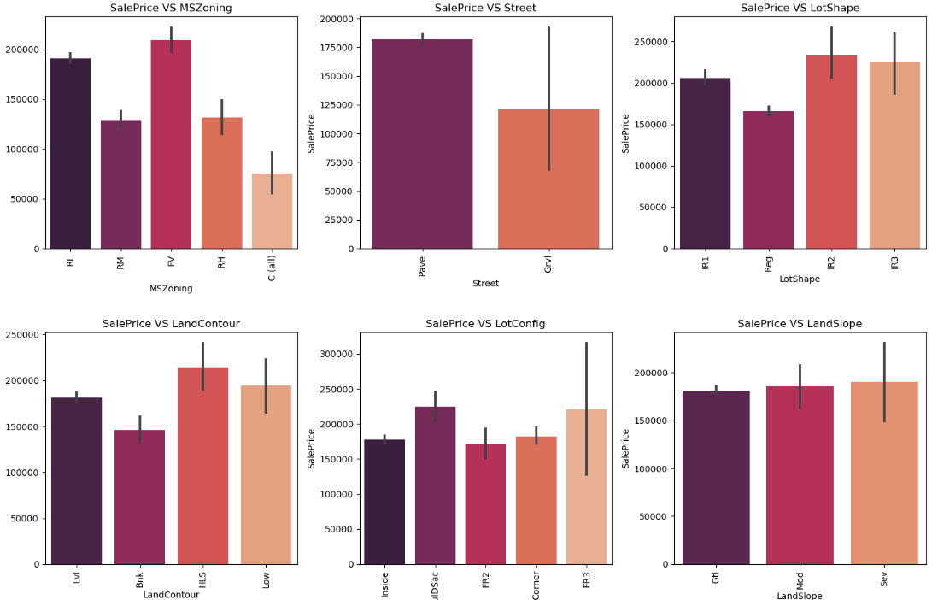
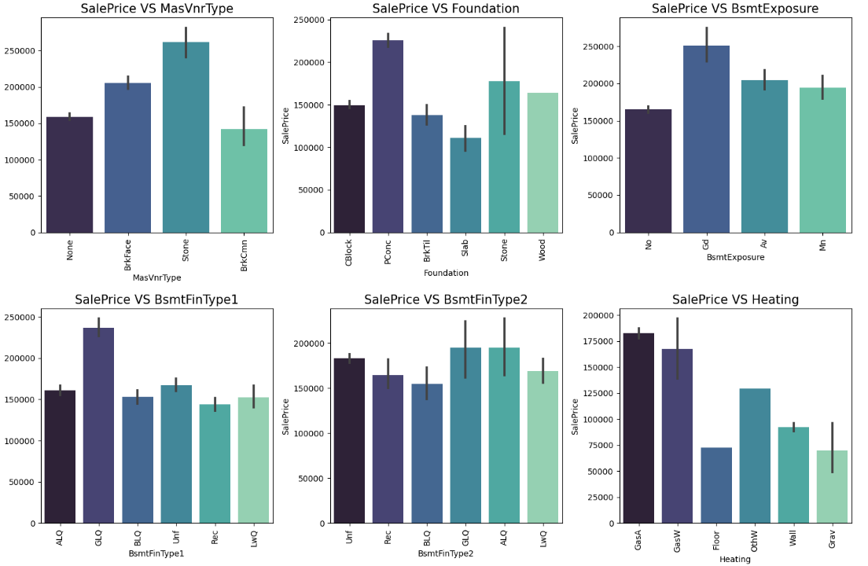
Bivariate Analysis – Target v/s Features

Slide 13
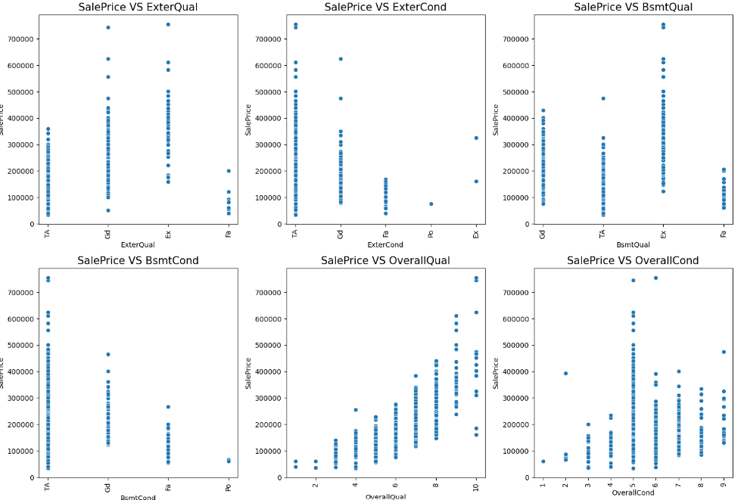
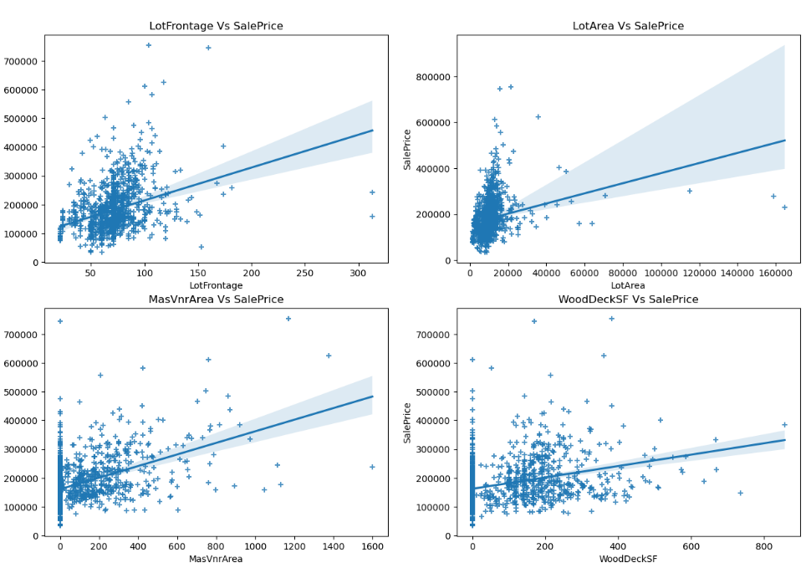
Bivariate Analysis – Target v/s Features

Slide 14
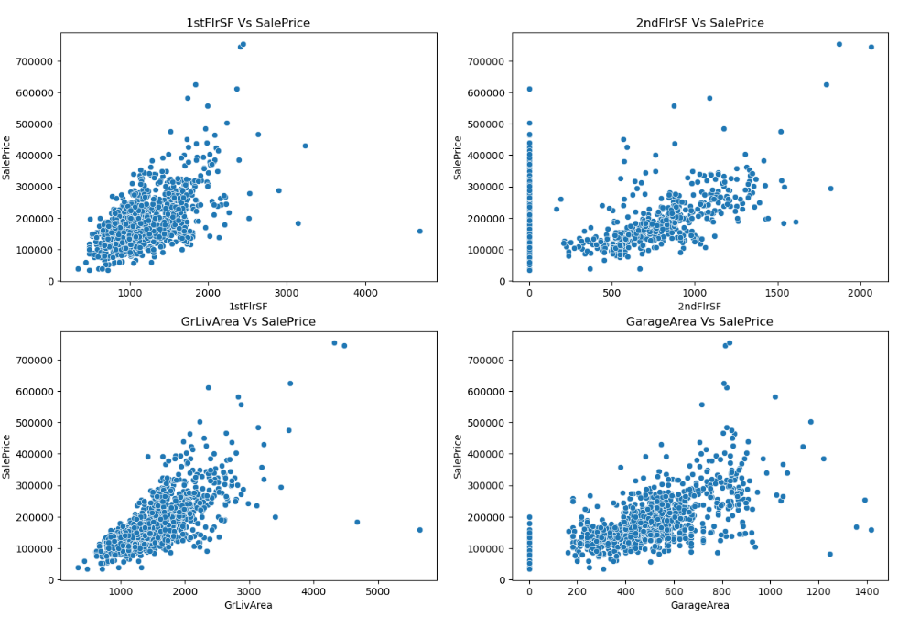
Bivariate Analysis – Visualizing Continuous Variables vs Sale Price

Slide 15
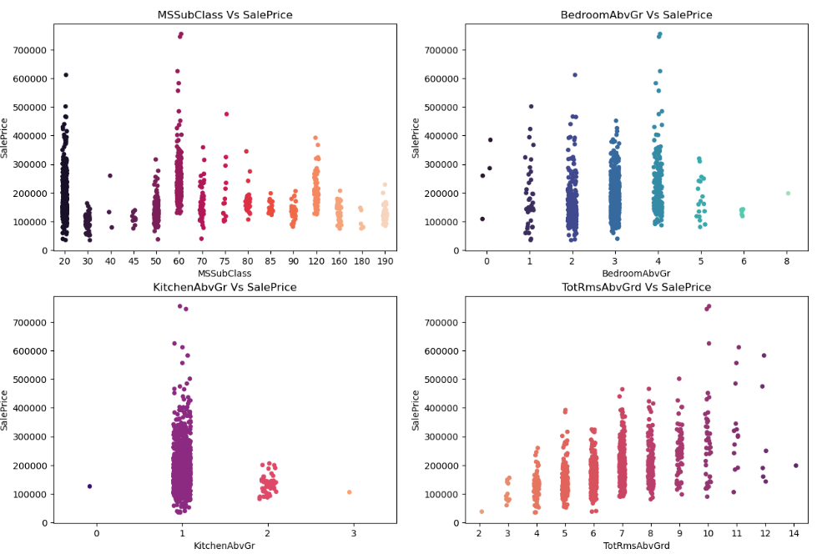
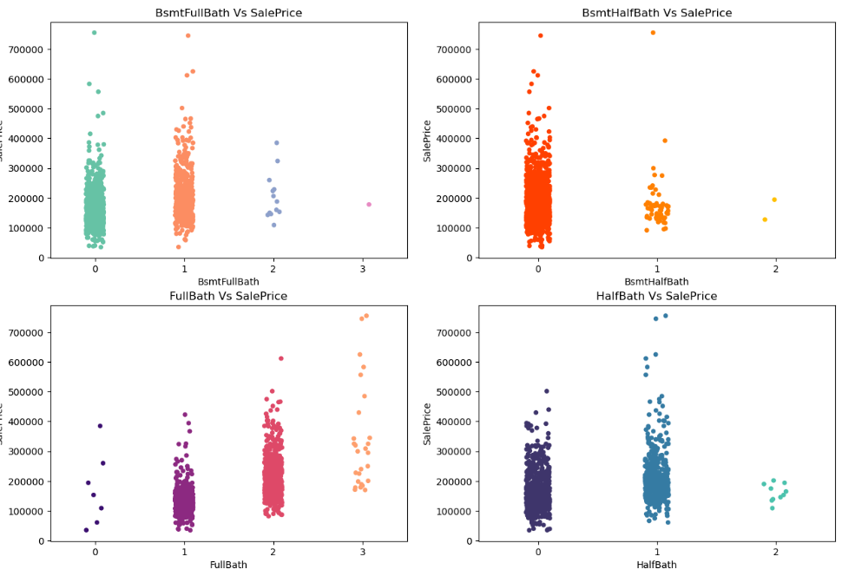
Bivariate Analysis – Visualizing Discrete Variables vs Sale Price

Slide 16
Analysis
Identified outliers using box plots in both datasets. I tried to remove them using both Zscore and IQR method and got huge data loss of around 24% and 48% respectively, so removed outliers using percentile method by setting data loss to 2%.
Checked for skewness and removed skewness in numerical columns using power transformation method (yeo-johnson). Also dropped KitchenAbvGr columns as it contains zero values throughout the data after using power transformation.
Encoded both train and test data frames using Ordinal Encoder. Also replaced some categorical columns having ratings by numbers based on specific condition.

Slide 17
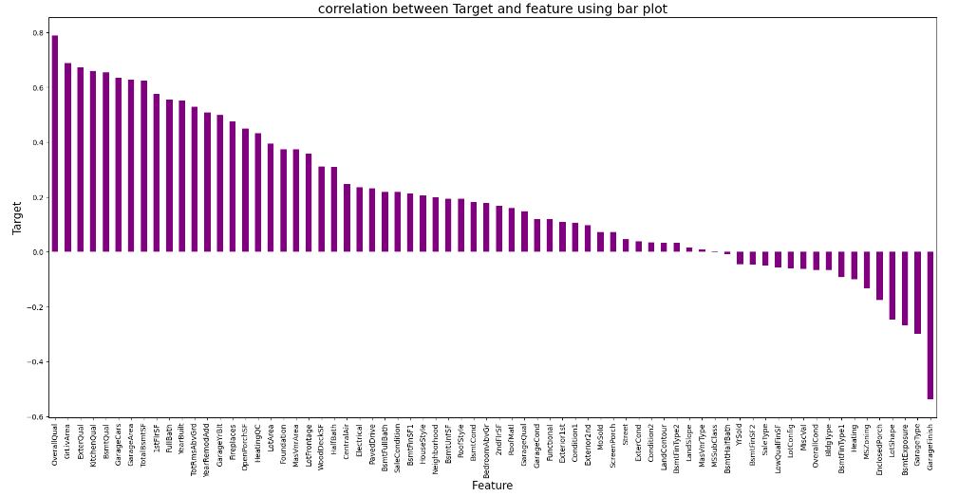
Correlation Between Features and Label
The bar plot shows the important features that affect Sale Price positively and negatively. We can easily notice the correlation here.

Slide 18
Analysis
Used Pearson’s correlation coefficient to check the correlation between dependent and independent variables. To visualize the correlation, I have used heatmap and bar plot.
I have used Standard Scalarization method to scale the data.
While checking the correlation I came across multicollinearity problem, I checked VIF values and removed GrLivArea to overcome with the multicollinearity issue.

Slide 19
Assumptions:
Firstly, from the problem statement which states that it is a Regression type problem for which we will be using Regressor algorithms to build our models and predict the sale price of the house.
Secondly, based upon the analysis and visualization part we have seen some of the features having linear relation with label. So, I assumed these features helps in model building and to predict the sale price of the house. Also, these features play and important role as if someone planned to buy a house he/she can decide whether to buy house or not based on these features like environment, area, quality of the house etc.
So, I suggest that people take into consideration the features that were deemed as most important as seen in this study might help them estimate the house price better.

Slide 20
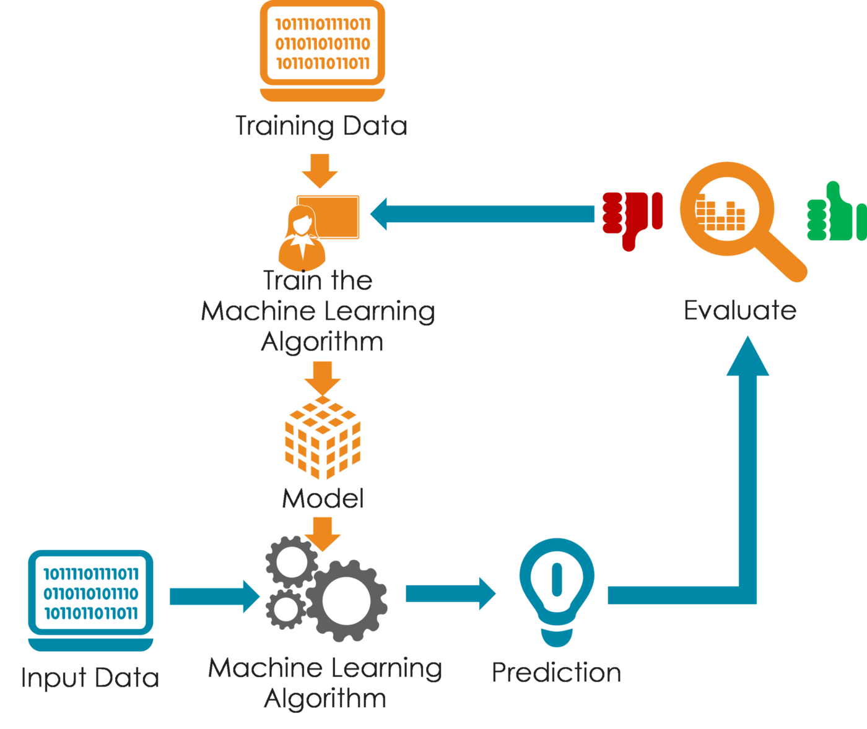
Model Building
Since SalePrice was my target and it was a continuous column so this perticular problem was regression problem. And I have used all regression algorithms to build my model. By looking into the difference of r2 score and cross validation score I found ExtraTreesRegressor as a best model with least difference. Also to get the best model we have to run through multiple models and to avoid the confusion of overfitting we have go through cross validation.

Slide 21
Model Building
Below are the list of regression algorithms I have used in my project.
Linear Regression
Lasso Regressor
Ridge Regressor
Decision Tree Regressor
Random Forest Regressor
Extra Trees Regressor
Gradient Boosting Regressor
Extreme Gradient Boosting Regressor (XGB)
Bagging Regressor

Slide 22
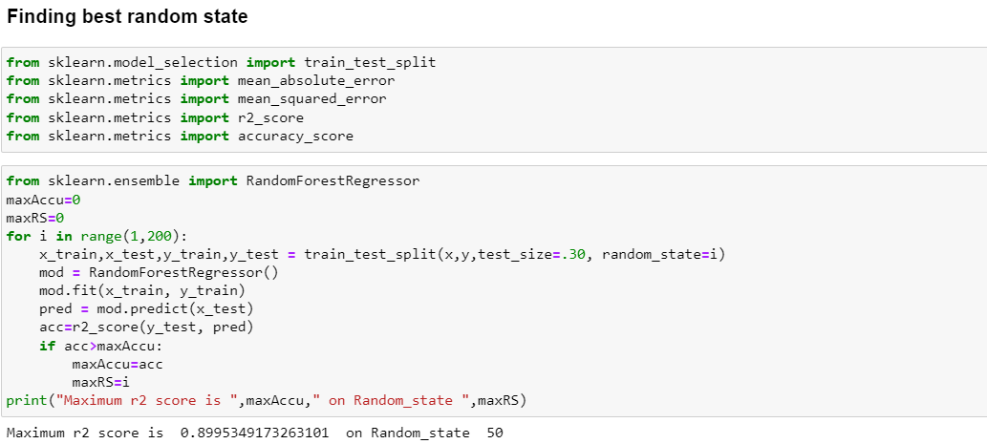
Best Random State

Slide 23
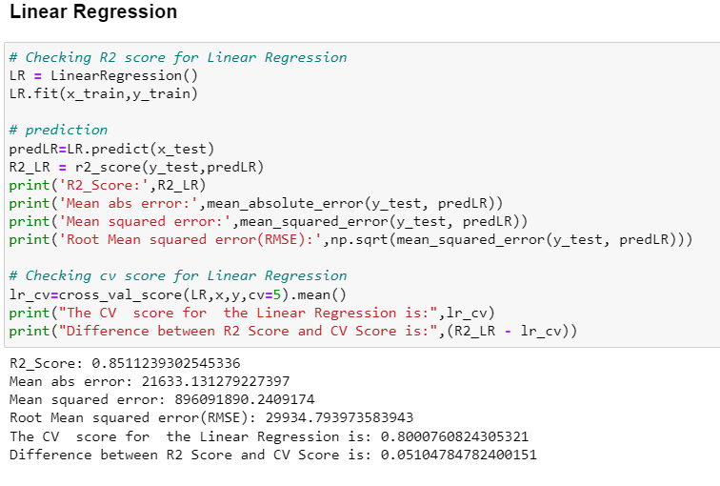
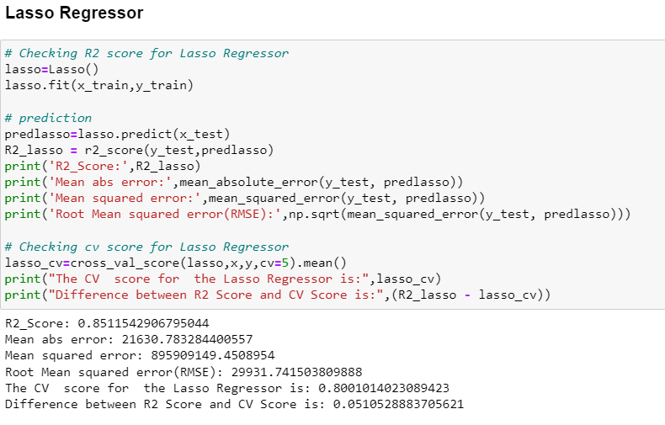

Slide 24
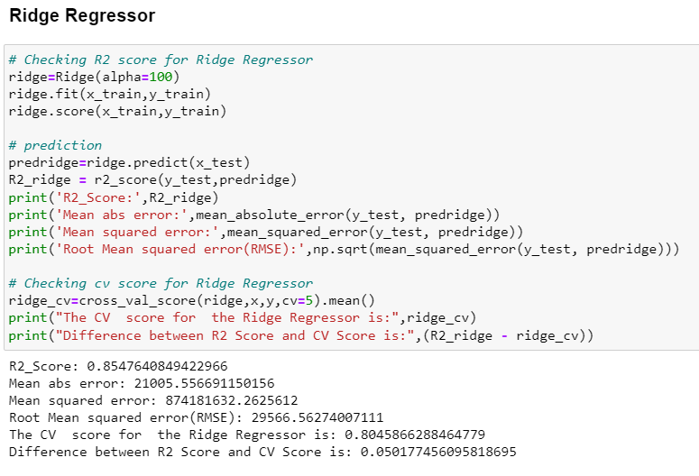
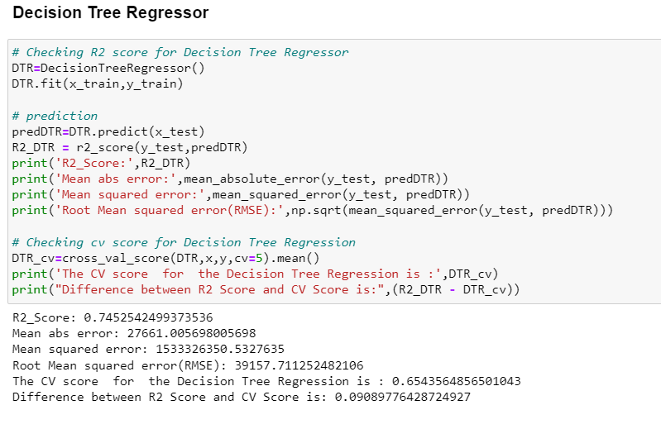

Slide 25
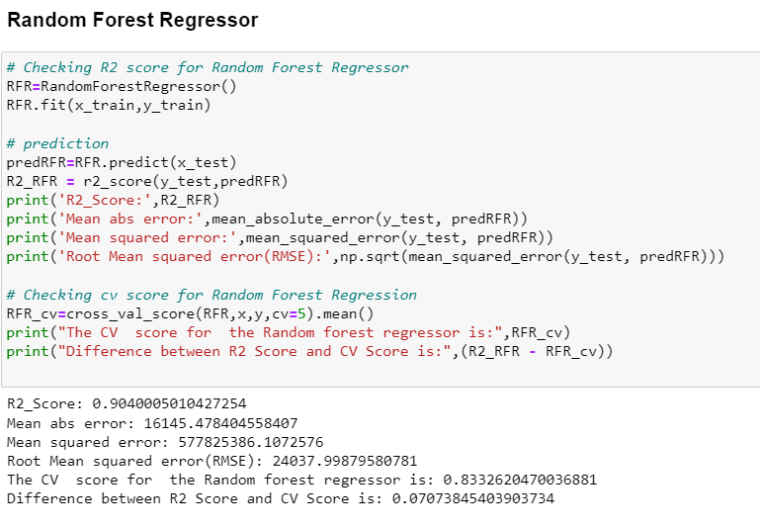
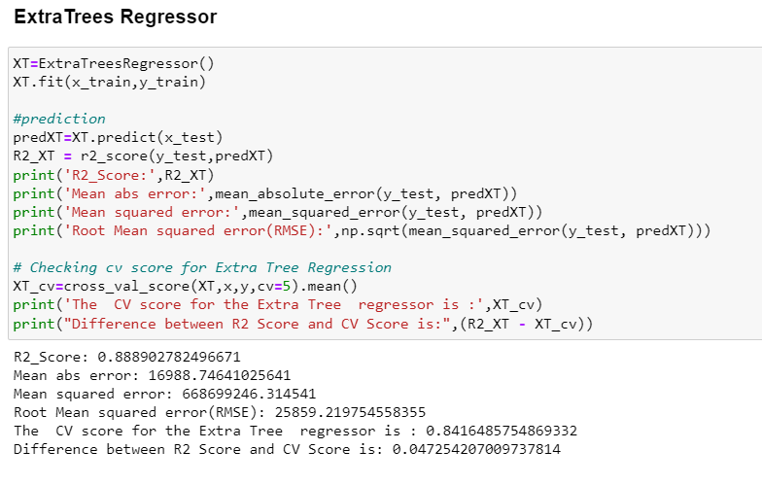

Slide 26
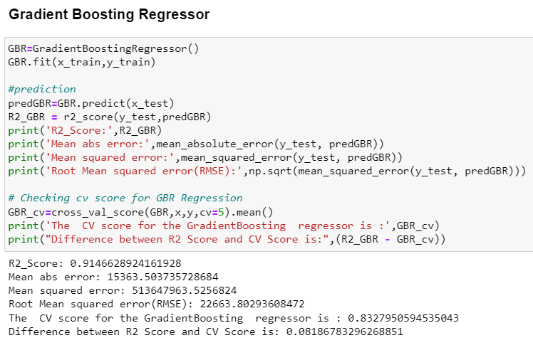
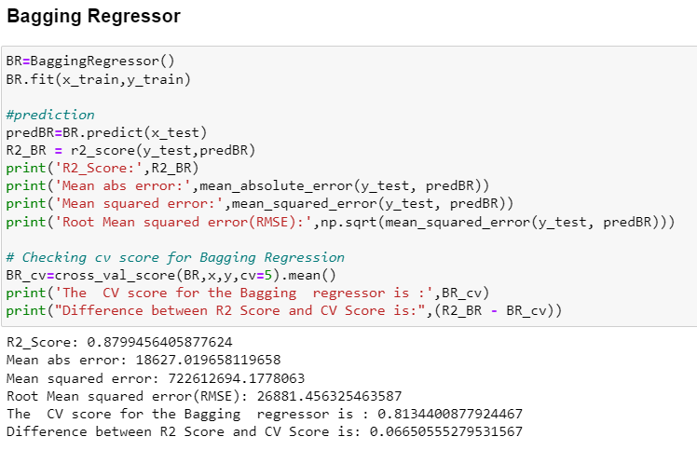

Slide 27
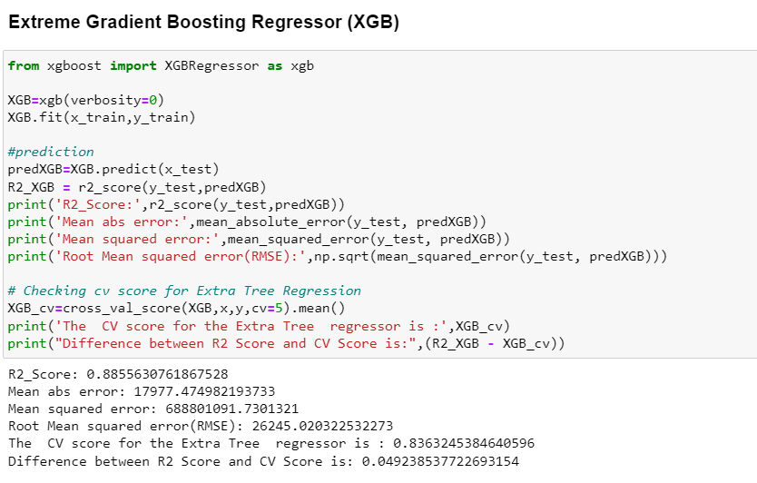
From all the algorithm used, looking at the difference of R2 score and the cross validation score we conclude that ExtraTrees Regressor is our best fitting model

Slide 28
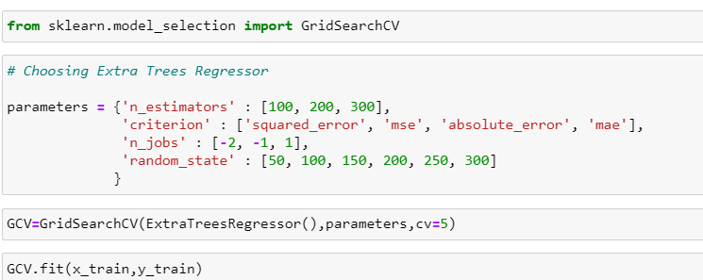
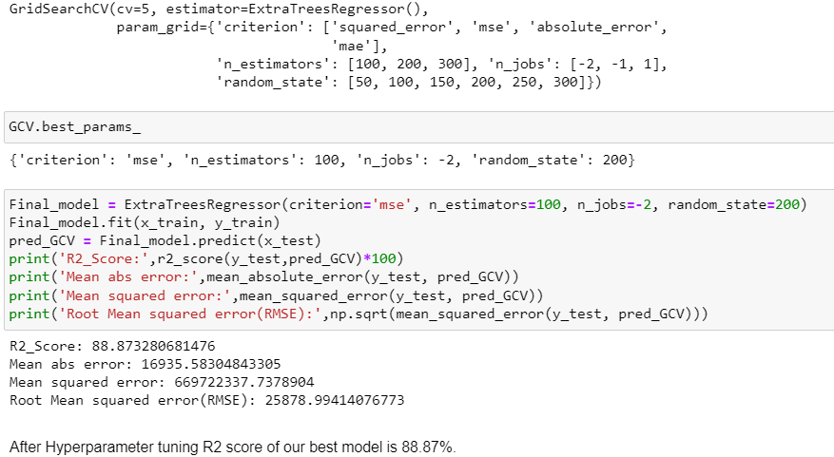
Hyper Parameter Tuning
I have used GridSearchCV to get the best parameters of Extra Tree Regressor. And used all the obtained parameters to get the accuracy of final model.

Slide 29
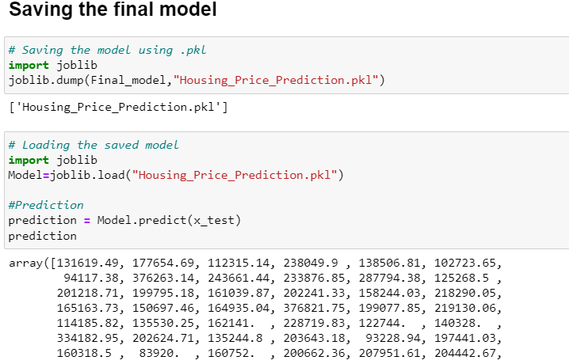
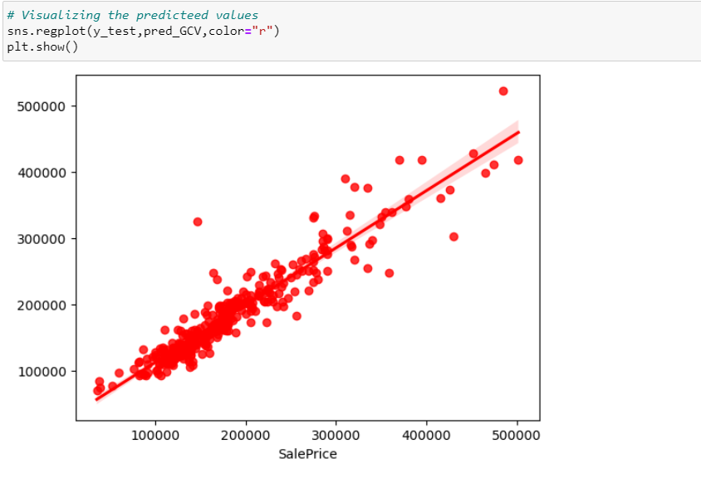
Saving the model and predictions using saved model
I have saved my best model using .pkl as follows.
Now after saving the best model, loading my saved model and predicting the test values.

Slide 30
Conclusion:
In this study, we have used multiple machine learning models to predict the house sale price. We have gone through the data analysis by performing feature engineering, finding the relation between features and label through visualizations. And got the important feature and we used these features as inputs to predict the price by building ML models.
We have got good prediction results. After using hyper parameter tuning, the best model R2 score was 89% also the errors decreased which means no over-fitting issue. And predicted the sale price for test data using saved best model.
Finally, our aim is achieved by predicting the house price for the test data, I hope this will be further helps for sellers and buyers to understand the house marketing. The machine learning models and data analytic techniques will have an important role to play in this type of problems. It helps the customers to know the future price of the houses.
As a recommendation, I advise to use this model by the people who want to buy a house in the area covered by the dataset to have an idea about the actual price. The model can be used also with datasets that cover different cities and areas provided that they contain the same features. I also suggest that people take into consideration the features that were deemed as most important as seen in this study might help them estimate the house price better.

Slide 31


